Slide 1

Structural Bioinformatics
R. Sowdhamini
National Centre for Biological Sciences
Tata Institute of Fundamental Research
Bangalore, INDIA

Slide 2
Prediction with inputs from
Structural Bioinformatics
Genome-wide analysis of protein families
Evolutionary relationships amongst proteins
Design of novel protein folds
Design of new function to an existing
scaffold

Slide 3
Recent technical advances
Sensitive sequence searches: profiles and HMMs
Large scale computing in cluster environment
Successful design of novel folds and new
functions
Notes:
This

Slide 4
Example of recent advances: 1
Genome-wide survey
Mechanisms of thermal adaptation revealed from the genome of the antarctic Archaea Methanogenium frigidum and Methanococcoides burtonii. Saunders et al., Genome Res 2003 (7):1580-8
Notes:
t
This is the first report on genomic analysis of cold-adapted
methanogenic archaea and their comparison to mesophiles and
thermophiles. This work provides genome-wide evidence for a
correlation of surface hydrophobic residues to cold-adaptation.
The partial sequences of Methanogenium frigidum and
Methanococcoides burtonii were used to show a preference for
noncharged polar amino acids, especially in solvent accessible
regions predicted from modeled proteins, and a reduction in
charged amino acids. The findings are consistent with an
important role for optimal surface energy and flexibility for protein
structure and function at reduced temperatures.

Slide 5
Examples of recent advances: 2
Function prediction
Using multiple sequence correlation analysis to characterize functionally important protein regions.
Saraf et al., Protein Eng 2003
16:397-406.
Notes:
In connection with the various structural genomics initiatives,
considerable effort is currently being devoted to identifying
functional protein regions from known amino acid sequence and
structure, such as the novel bioinformatics-inspired approach
used by these authors. As a result of evolution, many families have
diverged substantially so that it is typically difficult to observe
directly any distinct patterns. Furthermore, there are at present no
reliable techniques for identifying regions that may subtly affect
functionality by taking part in large numbers of interactions that
have co-evolved under functional or structural restraints. In this
work, the authors introduce the concept of a correlation tendency
metric in order to quantify the average number of other residues to
which a particular residue or region is correlated. They postulate
that mobile regions of a protein exhibit high correlation tendency
values that result from hydrogen bonds, van der Waals interactions
and long range electrostatic effects that may influence catalysis. In
order to test their hypothesis, they performed residue correlation
analysis (RCA) on three protein families: (i) dihydrofolate reductase
(DHFR), (ii) cyclophilin and (iii) formyl-transferase. Using this
approach, they were successful in developing a computational
framework for identifying protein regions that correlated to a large
number of other residues. They demonstrated that
residues/regions that have a high correlation tendency are either
involved in important interactions or participate in conformational
changes necessary for retaining function. Together with entropy
calculations, they were also able to identify the protein building
blocks that co-evolve under structural and functional constraints.
They confirmed that strongly correlated pairs and NOT contacting
pairs are better descriptors for identifying interacting residues, and
that RCA and entropic measures collectively form a better technique
to identify functionally important regions.

Slide 6
Examples of recent advances: 3
Protein-protein interactions
Interrogating protein interaction networks through structural biology. Aloy and Russell, Proc Natl Acad Sci U S A. 2002, 99:5896-901.
Notes:
Protein-protein interactions are central to most biological processes. Although much recent effort has been put into methods to identify interacting partners, there has been a limited focus on how these interactions compare with those known from three-dimensional (3D) structures. Because comparison of protein interactions often involves considering homologous, but not identical, proteins, a key issue is whether proteins that are homologous to an interacting pair will interact in the same way, or interact at all. Accordingly, we describe a method to test putative interactions on complexes of known 3D structure. Given a 3D complex and alignments of homologues of the interacting proteins, we assess the fit of any possible interacting pair on the complex by using empirical potentials. For studies of interacting protein families that show different specificities, the method provides a ranking of interacting pairs useful for prioritizing experiments. We evaluate the method on interacting families of proteins with multiple complex structures. We then consider the fibroblast growth factor/receptor system and explore the intersection between complexes of known structure and interactions proposed between yeast proteins by methods such as two-hybrids. We provide confirmation for several interactions, in addition to suggesting molecular details of how they occur.

Slide 7
Examples of recent advances: 4 targets for structural genomics
Automatic target selection for structural genomics on eukaryotes.
Liu et al., Proteins, 2004, 56:188-200.
Notes:
A central goal of structural genomics is to experimentally determine representative structures for all protein families. At least 14 structural genomics pilot projects are currently investigating the feasibility of high-throughput structure determination; the National Institutes of Health funded nine of these in the United States. Initiatives differ in the particular subset of "all families" on which they focus. At the NorthEast Structural Genomics consortium (NESG), we target eukaryotic protein domain families. The automatic target selection procedure has three aims: 1) identify all protein domain families from currently five entirely sequenced eukaryotic target organisms based on their sequence homology, 2) discard those families that can be modeled on the basis of structural information already present in the PDB, and 3) target representatives of the remaining families for structure determination. To guarantee that all members of one family share a common foldlike region, we had to begin by dissecting proteins into structural domain-like regions before clustering. Our hierarchical approach, CHOP, utilizing homology to PrISM, Pfam-A, and SWISS-PROT chopped the 103,796 eukaryotic proteins/ORFs into 247,222 fragments. Of these fragments, 122,999 appeared suitable targets that were grouped into >27,000 singletons and >18,000 multifragment clusters. Thus, our results suggested that it might be necessary to determine >40,000 structures to minimally cover the subset of five eukaryotic proteomes.

Slide 8
Examples of recent advances: 5 large scale modelling
Protein structure prediction for the male-specific region of the human Y chromosome. Ginalski et al., Proc Natl Acad Sci U S A. 2004, 101:2305-10.
Comparative protein structure modeling by iterative alignment, model building and model assessment. John & Sali Nucleic Acids Res. 2003, 31:3982-92.
Notes:
The complete sequence of the male-specific region of the human Y chromosome (MSY) has been determined recently; however, detailed characterization for many of its encoded proteins still remains to be done. We applied state-of-the-art protein structure prediction methods to all 27 distinct MSY-encoded proteins to provide better understanding of their biological functions and their mechanisms of action at the molecular level. The results of such large-scale structure-functional annotation provide a comprehensive view of the MSY proteome, shedding light on MSY-related processes. We found that, in total, at least 60 domains are encoded by 27 distinct MSY genes, of which 42 (70%) were reliably mapped to currently known structures. The most challenging predictions include the unexpected but confident 3D structure assignments for three domains identified here encoded by the USP9Y, UTY, and BPY2 genes. The domains with unknown 3D structures that are not predictable with currently available theoretical methods are established as primary targets for crystallographic or NMR studies. The data presented here set up the basis for additional scientific discoveries in human biology of the Y chromosome, which plays a fundamental role in sex determination.

Slide 9
Examples of recent advances: 6
Docking and inhibitor design
Discovery of a potent and selective protein kinase CK2 inhibitor by high-throughput docking. Vangrevelinghe et al., J Med Chem. 2003, 46:2656-62.
Structural modes of stabilization of permissive phosphorylation sites in protein kinases: distinct strategies in Ser/Thr and Tyr kinases. Krupa et al., J Mol Biol. 2004, 339:1025-39.
Notes:
This paper reports the discovery of a potent and selective CK2 inhibitor by in silico virtual screening of a compound library using a homology model of human CK2; this paper is a must read for everybody interested in homology modeling and structure based drug design. A typical situation in drug development: how to identify a selective and potent inhibitor for a new target when no crystal structure is available? The authors addressed this question by an elegant combination of homology modeling and high throughput docking using a Grid computing architecture of hundreds of desktop PCs. The discovery of a highly potent (IC50 of 80 nM) and selective CK2 inhibitor proves the validity of this approach, and provides a valuable tool for the study of the biological function of CK2.
Most protein kinases are subjected to positive and negative regulation by phosphorylation of Ser/Thr/Tyr residues at specific sites within and outside the catalytic core. The current review describes the analysis on 3D structures of protein kinases that revealed features distinct to active states of Ser/Thr and Tyr kinases. The nature and extent of interactions among well-conserved residues surrounding the permissive phosphorylation sites differ among the two classes of enzymes.

Slide 10
Examples of recent advances: 7
Design of new function
Computational design of a biologically active enzyme. Dwyer et al., Science 2004, 304:1967-71.

Slide 11
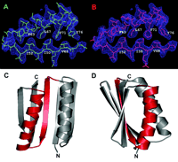
Examples of recent advances: 8
Design of novel fold
Design of a novel globular protein fold with atomic-level accuracy. Kuhlman et al., Science 2003, 302:1364-8.
Notes:
This remarkable paper reports the successful synthesis of a novel 93-residue protein with a unique topology not present in the database. The authors have struck a perfect balance between sequence optimization and structure prediction to model a fold that surprisingly matches the experimentally determined structure of the synthetic protein. Top7 might therefore be considered as our first step in the understanding of the protein folding problem.

Slide 12
Protein folding |||
Sequence alignment |||
Protein structure prediction |||||||
Secondary structure prediction ||||||||||
Side chain prediction ||
Protein structure comparisons ||||||||||

Slide 13
Protein-protein interactions ||||||||||||
Protein-RNA interactions ||
Protein structure analysis |||||
Function prediction |||||
Homology modelling |||
Visualisation server |||
Miscellaneous |||||

Slide 14
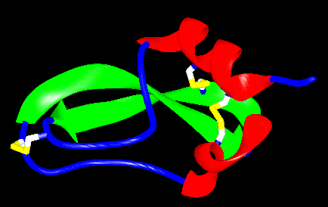
Prediction and Structural Bioinformatics
How does a protein fold?
YNRLCIKPRDWIDECDSNEGGERAYFRNG
KGGCDSFWICPEDHTGADYYSSYRDCFNACI
Papers in this session

Slide 15
Prediction and Structural Bioinformatics
Can functionally important residues
be recognised?
Can structure prediction lead
to function prediction?

Slide 16
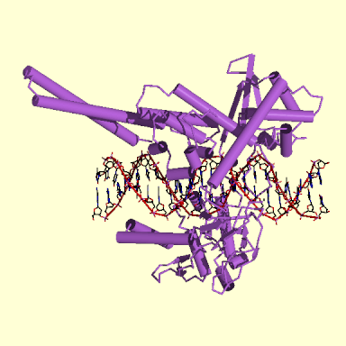
Prediction and Structural Bioinformatics
How does a protein recognise its ligand?
Paper in this session
What happens subsequent
to ligand binding?

Slide 17
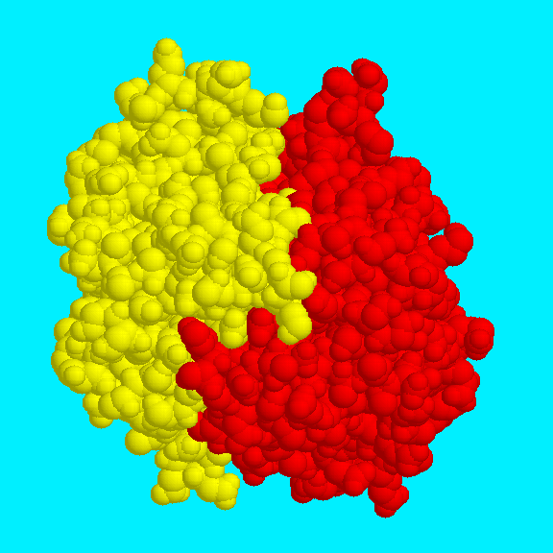
Prediction and Structural Bioinformatics
How do protein-protein interactions happen?
Paper in this session

